Slide 1

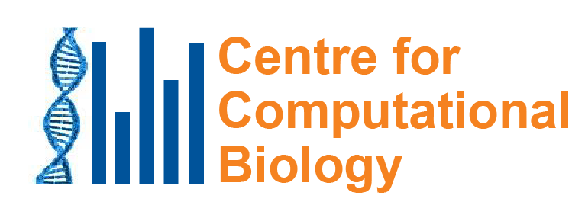
What can mutational signatures tell us about the causes of cancer?
Steven G. Rozen
September 7, 2023
國立成功大學醫學院
steverozen@pm.me
https://github.com/Rozen-Lab/msigs
Notes:
25 minute talk

Slide 2




Thank you for sponsoring my visit to Taiwan
| Graduate Institute of Biomedical Sciences
Dean Chun-Yen Lin 林俊彥教授, Dean of College of Medicine, CGU
Professor Ming-Ling Kuo 郭敏玲教授, Director, Graduate Institute of Biomedical Sciences, CGU
Dr Ian Y. F. Zhang 張益峯, Molecular Medicine Research Center, CGU

Slide 3
Outline
Background on mutational signatures
Many East Asian lung cancers in smokers do not have mutations due to smoking
AA (aristolochic acid, 馬兜鈴酸) and liver cancer

Slide 4
Outline
Background on mutational signatures
Many East Asian lung cancers in smokers do not have mutations due to smoking
AA (aristolochic acid, 馬兜鈴酸) and liver cancer

Slide 5
A quick review on somatic mutations
Every time our cells divide, mutations arise
Mutations not present in the fertilized egg are somatic mutations
We will focus on somatic mutations
Cancers have many somatic mutations

Slide 6
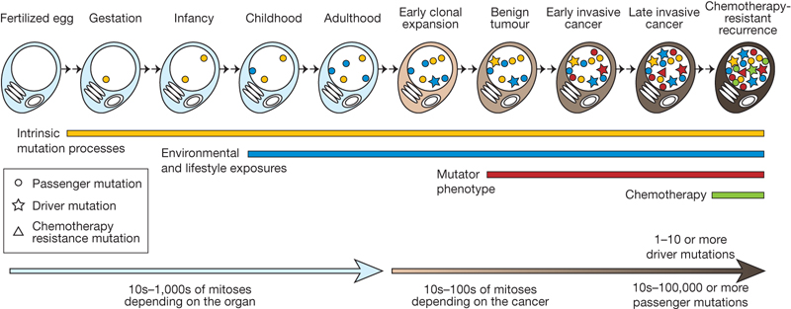
We detect somatic mutations by DNA sequencing normal cells and tumour cells
Normal
Normal
…ACGTCCTAGTCAAAATCGAGCC…

Slide 7
We detect somatic mutations by DNA sequencing normal cells and tumour cells
and tumor cells
Normal
Tumor
…ACGTCCTAGTCAAAATCGAGCC…
…ACGTCCTAGTCTAAATCGAGCC…

Slide 8
We detect somatic mutations by DNA sequencing normal cells and tumour cells
and tumor cells
We look for the variants found only in the tumor
Normal
Tumor
…ACGTCCTAGTCAAAATCGAGCC…
…ACGTCCTAGTCTAAATCGAGCC…

Slide 9
We detect somatic mutations by DNA sequencing normal cells and tumour cells
and tumor cells
We look for the variants found only in the tumor
Normal
Tumor
…ACGTCCTAGTCAAAATCGAGCC…
…ACGTCCTAGTCTAAATCGAGCC…
Somatic mutation from A → T
CAA → CTA
Useful information in neighboring bases

Slide 10
Concept of “mutational signature”
Examine patterns of somatic mutations in a tumor to infer mutational exposures or processes that led to the mutations
There can be different types of mutation patterns
Today we will focus on single-base mutations in the context of preceding and following bases

Slide 11
We usually detect somatic mutations by DNA sequencing normal cells and tumour cells
and tumor cells
We look for the variants found only in the tumor
Normal
Tumor
…ACGTCCTAGTCAAAATCGAGCC…
…ACGTCCTAGTCTAAATCGAGCC…
Somatic mutation from A → T
context of preceding and following bases
CAA → CTA
Useful information in neighboring bases

Slide 12
We look at all mutations found by whole genome or whole exome sequencing (most are not causing the cancer; they are innocent bystanders)

Slide 13
We look at all mutations found by whole genome or whole exome sequencing (most are not causing the cancer; they are innocent bystanders)
We want to know: what processes mutated the DNA?
?

Slide 14
We look at all mutations found by whole genome or whole exome sequencing (most are not causing the cancer; they are innocent bystanders)
We want to know: what processes mutated the DNA?
Later we can think about what the mutations tell us about the causes of cancer
?

Slide 15
Computational analysis of large databases
Experimental
delineation
Discovery
Mutational Signatures

Slide 16
Computational analysis of large databases
Experimental
delineation
Discovery
Mutational Signatures
Which mutational processes cause cancer?
Understanding
DNA damage &repair
Applications
External (exogenous) exposure
Cancer epidemiology
Mutations caused by endogenous processes

Slide 17
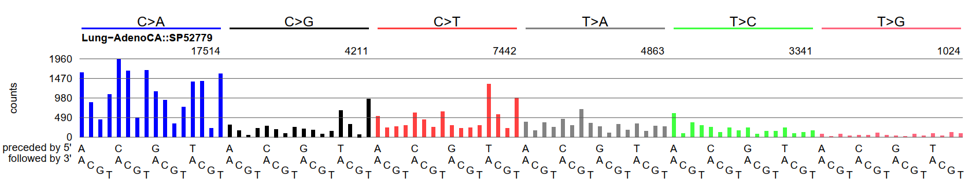
Example mutational spectrum
This graph shows the numbers of single base mutations in the contexts of preceding and following bases

Slide 18
Example mutational spectrum
This graph shows the numbers of single base mutations in the contexts of preceding and following bases
This is from a lung adenocarcinoma with lots of mutations caused by smoking

Slide 19
Example mutational spectrum
CTG to CAG mutations
~630 mutations
Highest blue bar represents the number of CCA to CAA mutations across the entire genome
The higher the bar, the more CCA to CAA mutations
1,960 mutations
Highest red bar = the number of TCA to TTA mutations across the entire genome;
~1,350 mutations

Slide 20
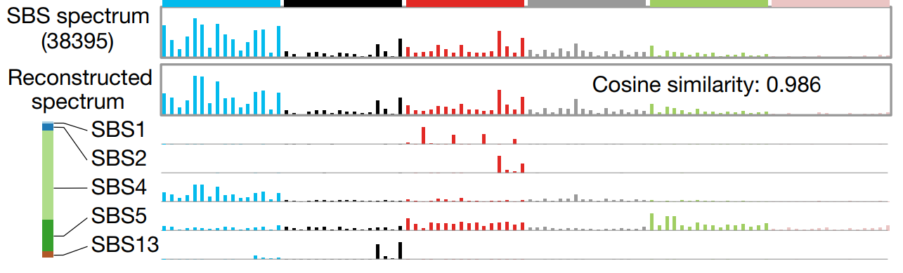
A mutational spectrum is the sum of mutations due to several mutational signatures
Alexandrov, …., Rozen, Stratton, 2020, 10.1038/s41586-020-1943-3 cited > 2000 times

Slide 21
Mutational signature discovery (data mining) usually uses non-negative matrix factorization (NMF)
Each cell contains level of exposure of 1 tumor to 1 signature
23,000 tumors
W
X
H
N
signatures
96 mutation types
23,000 tumors
N
signatures
≈
V (observed mutations)
96 mutation types
Alexandrov, …., Rozen, Stratton, 2020, 10.1038/s41586-020-1943-3 cited > 2000 times

Slide 22
We used non-negative-matrix-factorization techniques to analyze mutations from 23,000 tumors to generate a “reference set” of approximately 50 mutational signatures

Slide 23
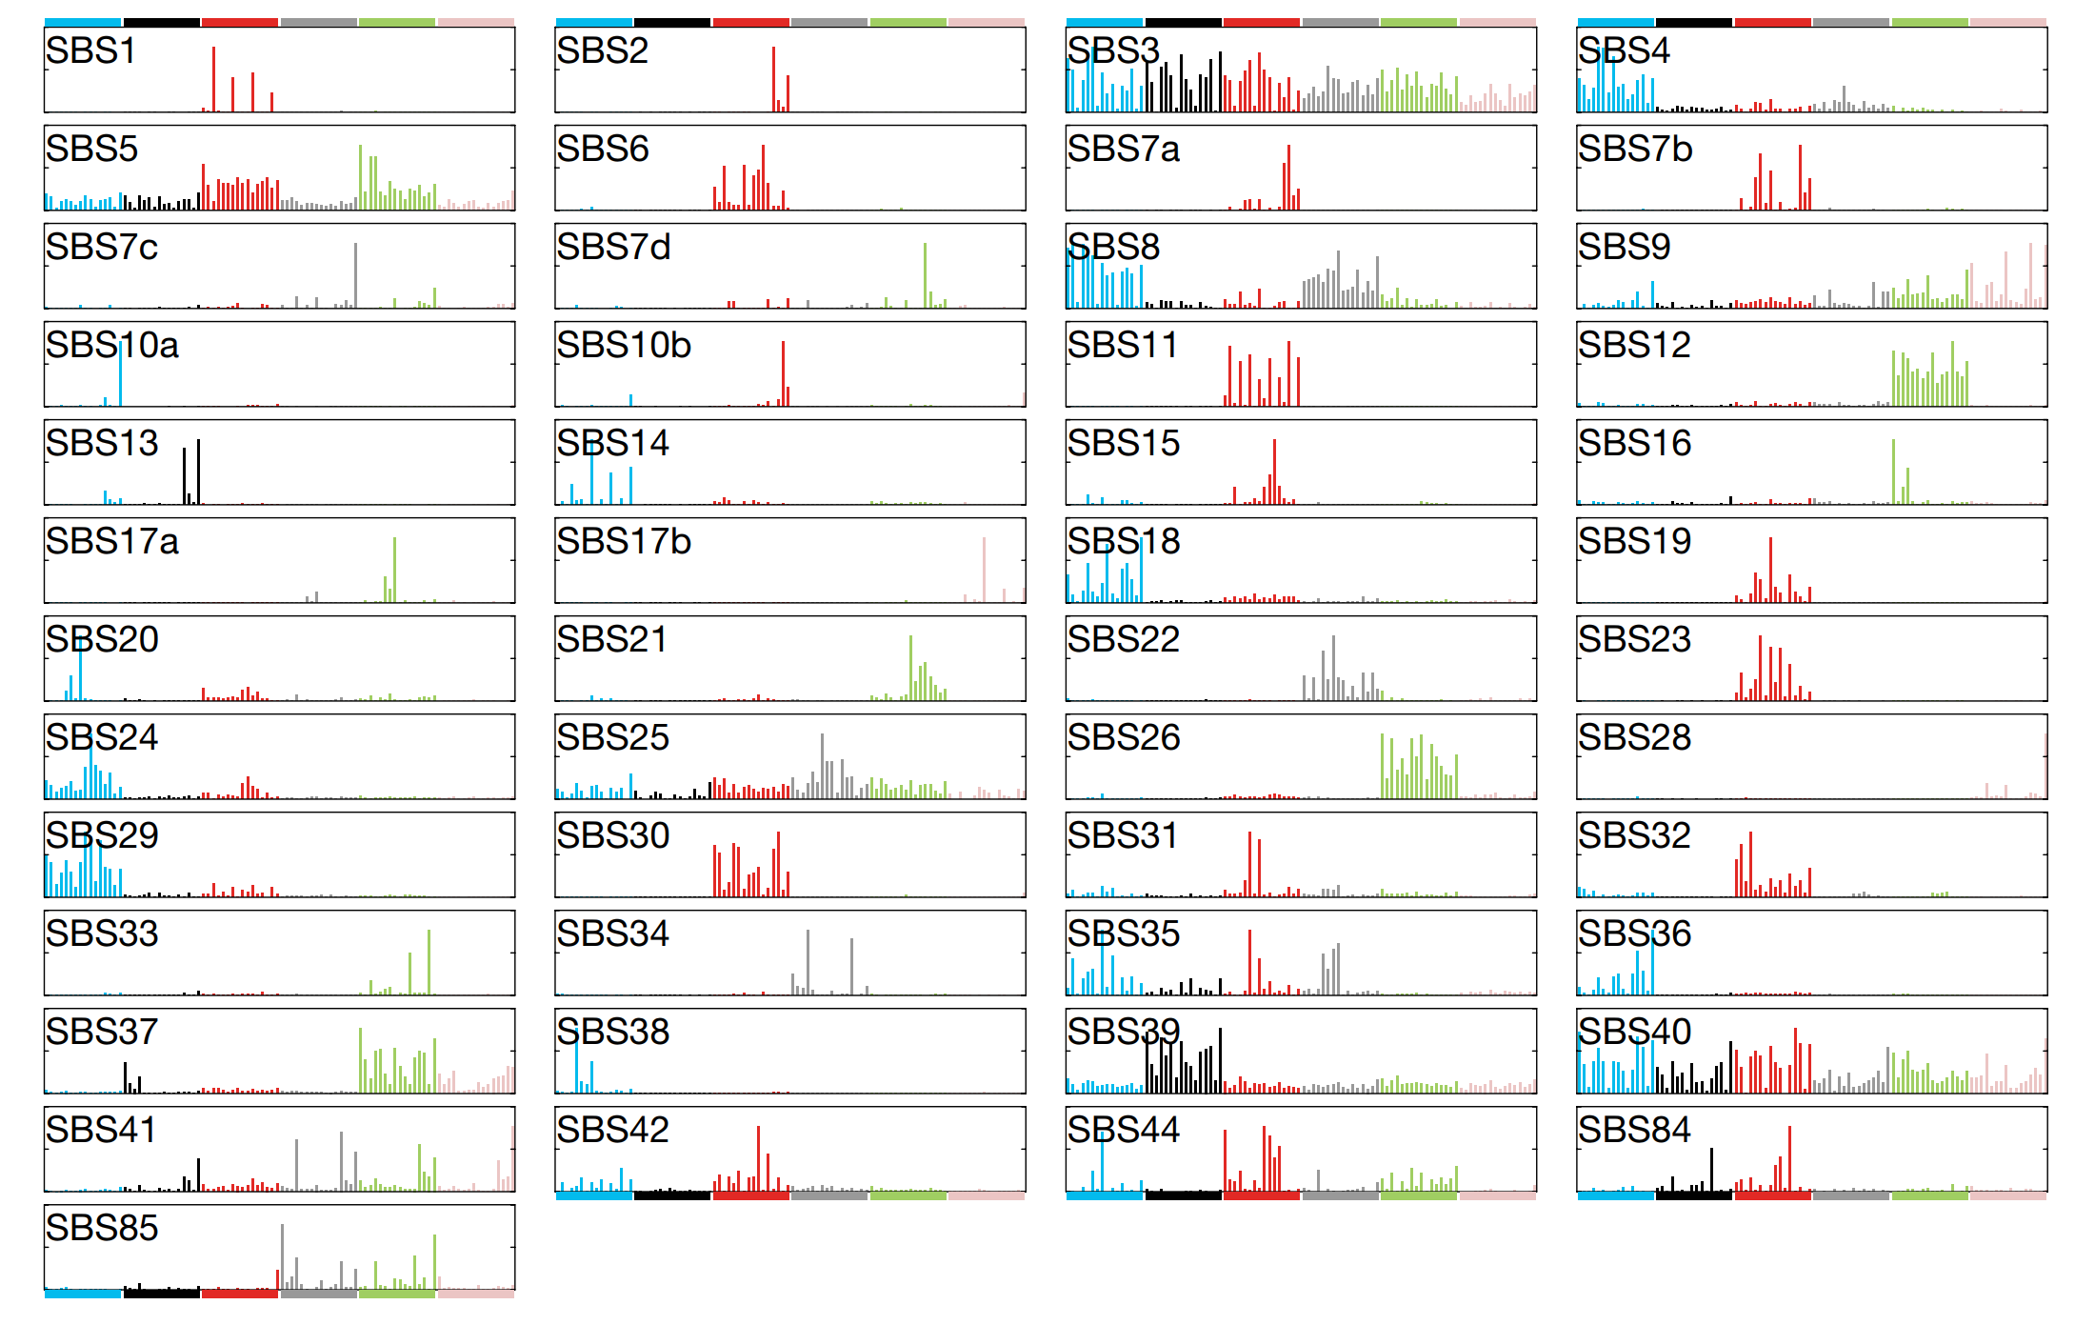
Reference set of signatures mined from 23,000 tumors
Alexandrov, …., Rozen, Stratton, 2020, 10.1038/s41586-020-1943-3

Slide 24
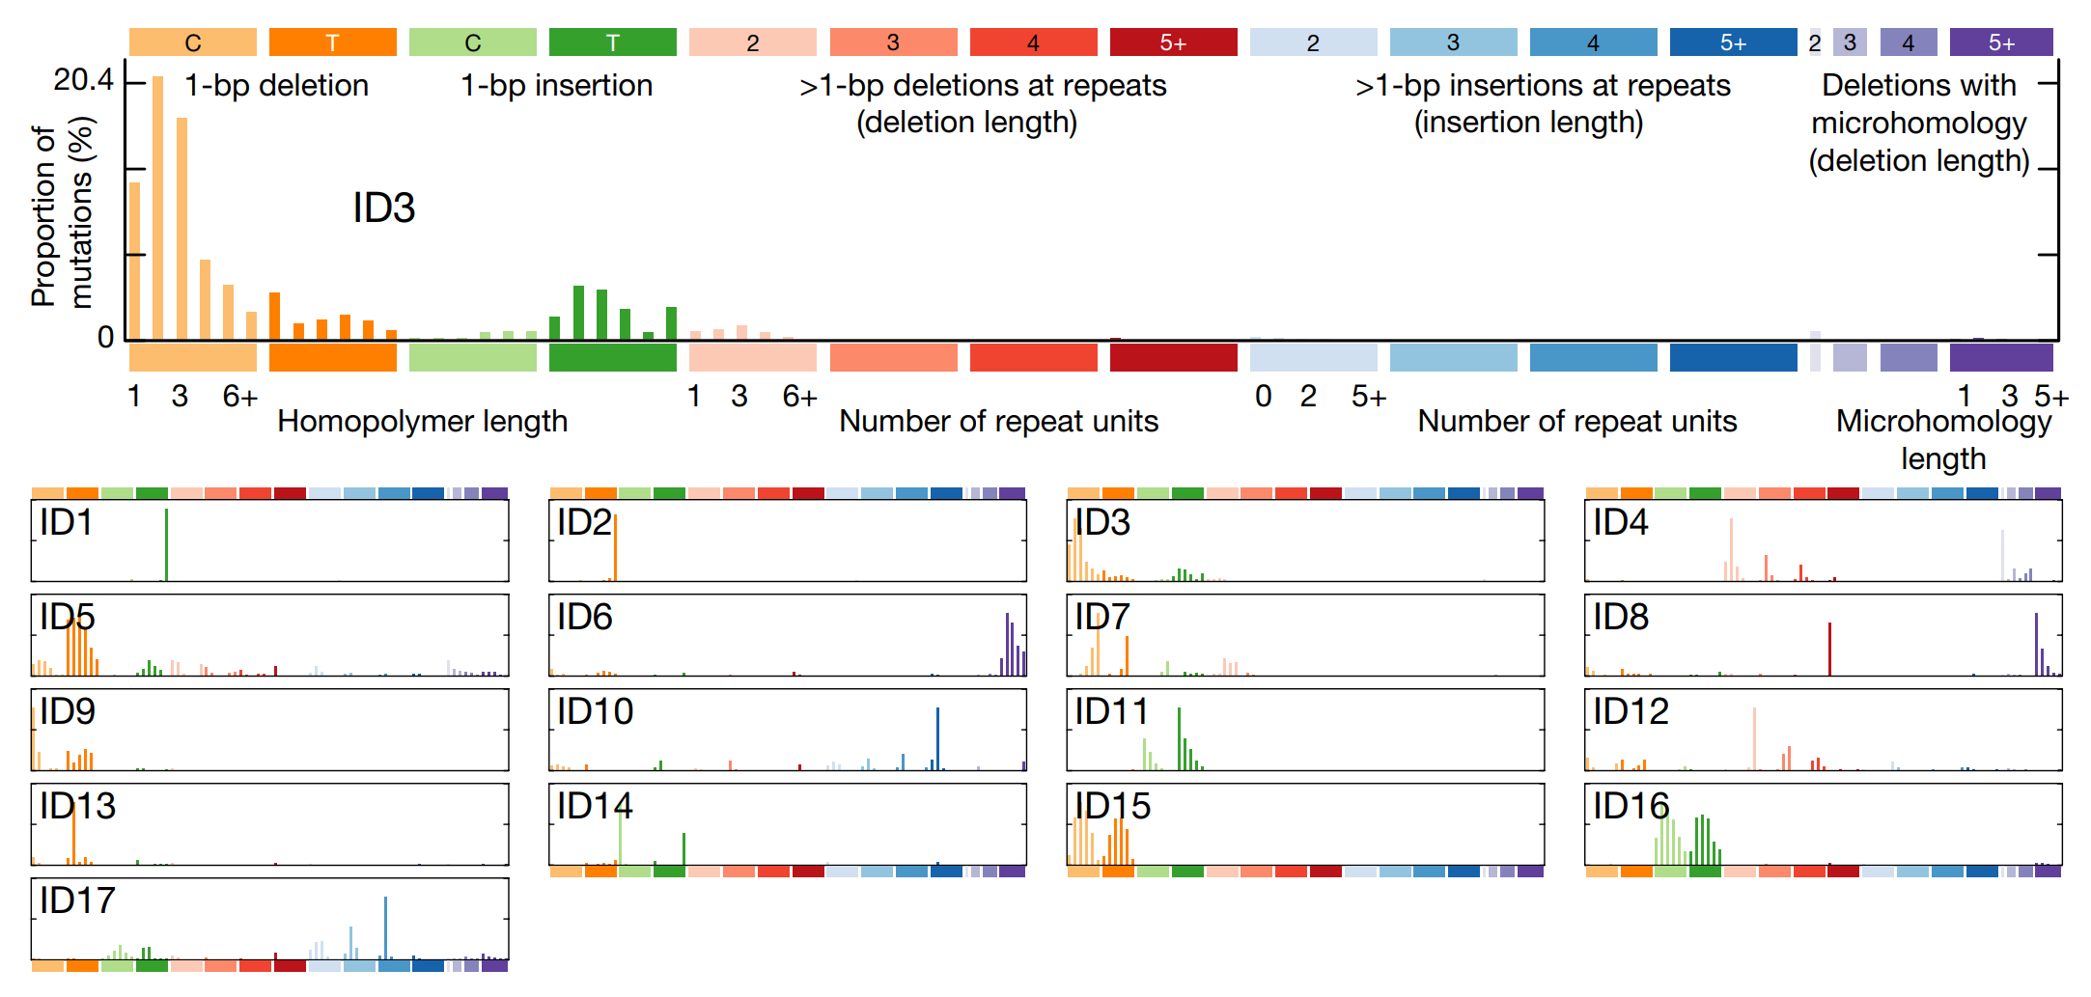
We also created a refence set of insertion and deletion mutational signatures
Alexandrov, …., Rozen, Stratton, 2020, 10.1038/s41586-020-1943-3

Slide 25
Example indel (insertion/deletion) signature ID17
E.g. ACATG → ACATCATG
(3 base-pair duplication)
E.g. CGATAC → CGATAGATAG
(4 base-pair duplication)
E.g. CATG → CATATG
(2 base-pair duplication)
Boot, Liu, et al., 2023, 10.1073/pnas.2114024119

Slide 26
It is very useful to have reference set of mutational signatures
Paper cited > 2,000 times since 2020
Many signatures are supported by experiments (for example by exposing cultured cells to mutagens)
Others are supported by association with known exposures
Updated reference set (maintained by Ludmil Alexandrov) is at COSMIC https://cancer.sanger.ac.uk/signatures/

Slide 27
Outline
Background on mutational signatures
Many East Asian lung cancers in smokers do not have mutations due to smoking
AA (aristolochic acid, 馬兜鈴酸) and liver cancer

Slide 28
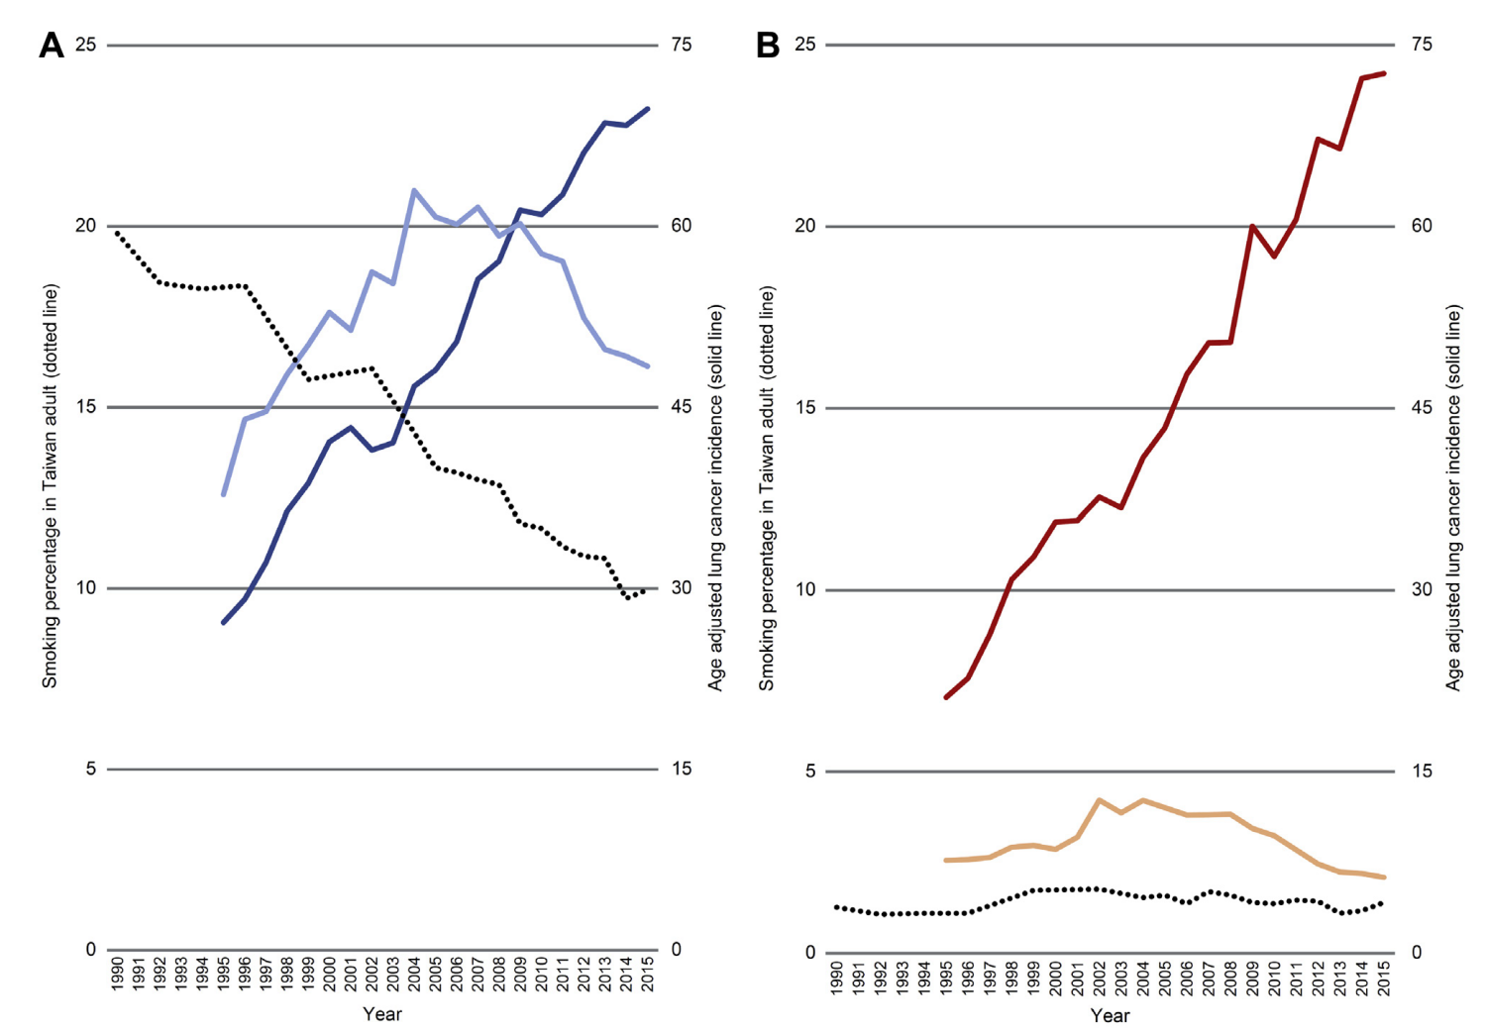
Context: Lung cancer in non-smokers in Taiwan (and East Asia in general) is increasing
Women
25
75
Lung adenocarcinoma
Percent smokers
Age-adjusted incidence (solid line)
Other lung cancer
% smokers
0
0
1990
2015
Year
Tseng, 2019, doi: 10.1016/j.jtho.2018.12.033

Slide 29
Context: Lung cancer in non-smokers in Taiwan (and East Asia in general) is increasing
Men
Women
25
Lung adenocarcinoma
75
25
75
Lung adenocarcinoma
% smokers
Other lung cancer
Percent smokers
Age-adjusted incidence (solid line)
Percent smokers
Age-adjusted incidence (solid line)
Other lung cancer
% smokers
0
0
0
0
1990
2015
1990
2015
Year
Year
Tseng, 2019, doi: 10.1016/j.jtho.2018.12.033

Slide 30
Lung cancer in East-Asian non-smokers
Causes of increasing incidence are unclear (cooking fumes, air pollution, hereditary factors…?)
Oncogenic mutations found in 70% to 90% of lung adenocarcinomas in non-smokers
This is an “oncogene-driven disease”
¹Guo, 2015.

Slide 31
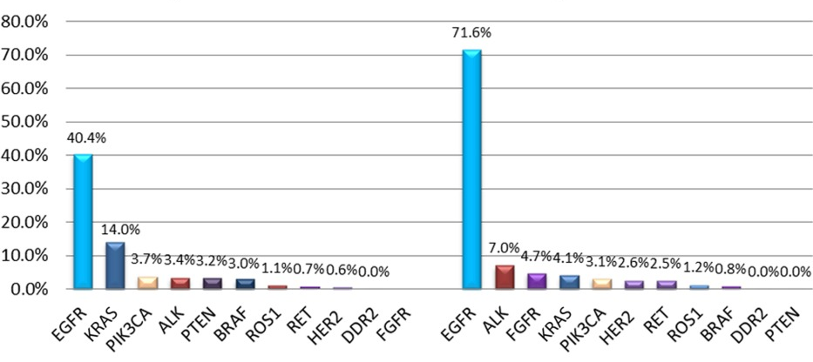
Some oncogenes are more often mutated in non-smokers
Smokers versus Non-smokers
% tumors with mutation in given oncogene
Smokers
Non-smokers
Oncogene
Gou, 2015, 10.1002/cncr.29531

Slide 32
Some oncogenes are more often mutated in non-smokers
Smokers versus Non-smokers
% tumors with mutation in given oncogene
Smokers
Non-smokers
Oncogene
Gou, 2015, 10.1002/cncr.29531

Slide 33
Other oncogenes are more often mutated in smokers
Smokers versus Non-smokers
% tumors with mutation in given oncogene
Smokers
Non-smokers
Oncogene
Gou, 2015, 10.1002/cncr.29531

Slide 34
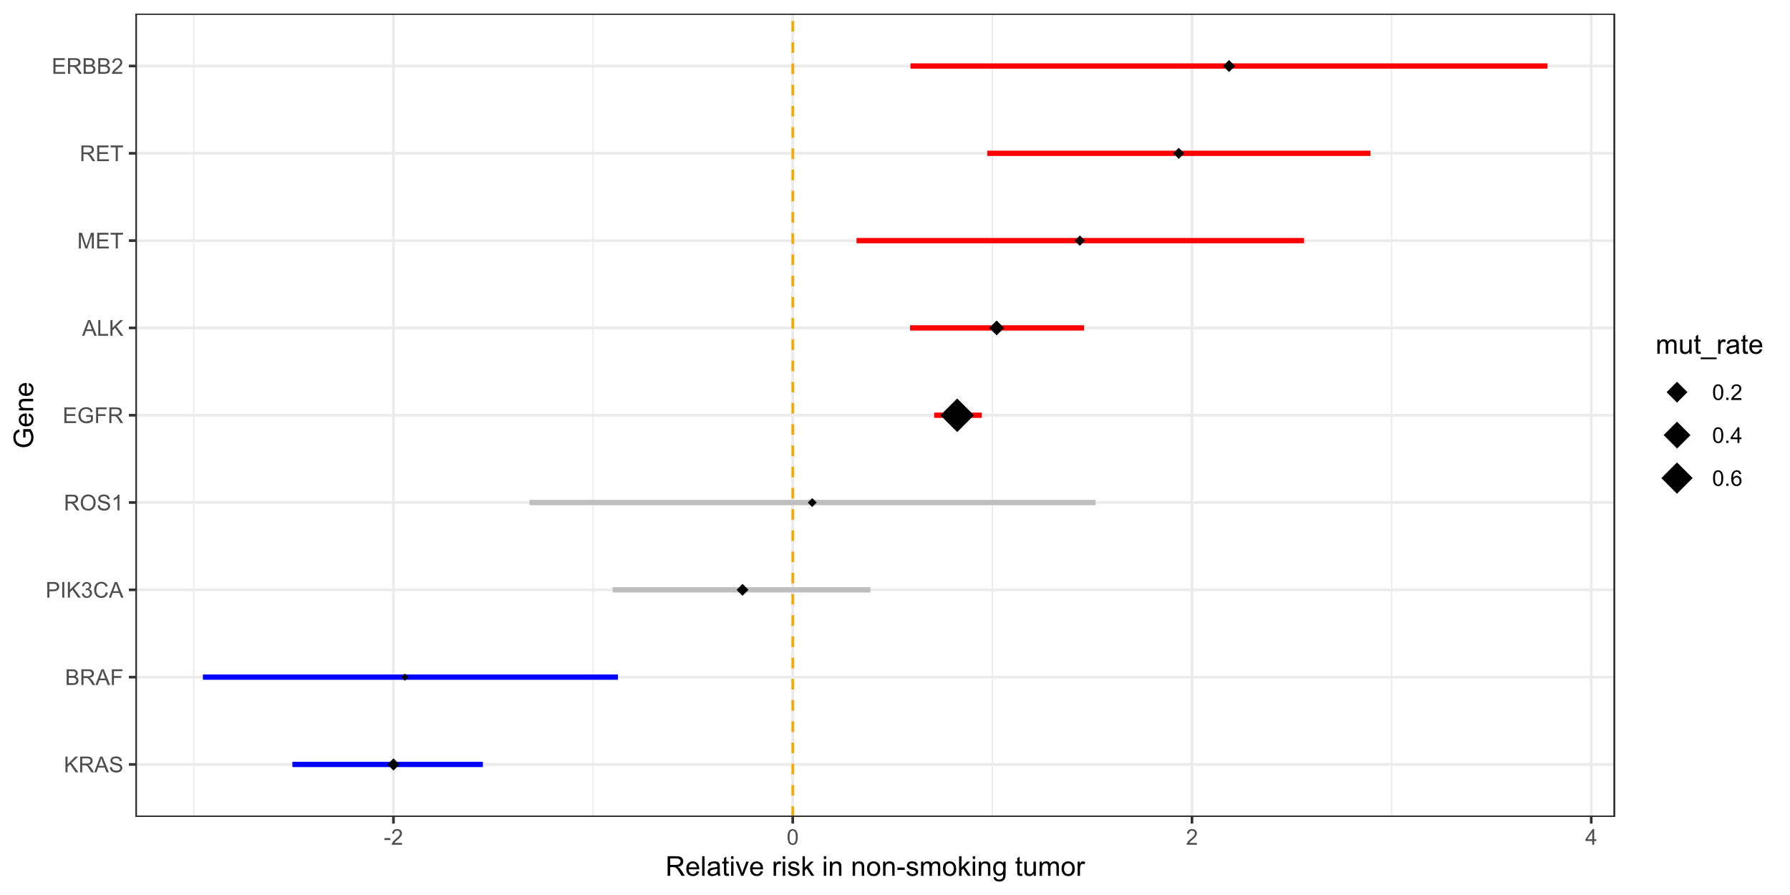
Non-Smoking-Related Oncogenes “NSROs”: oncogenes more frequently mutated in non-smokers
Relative prevalence of oncogene mutations in non-small-cell lung cancers
ERBB2 exon 20 insertion
RET fusion
MET exon 14 skipping
ALK fusion
EGFR exons 18 to 21 mut
ROS1 fusion
PIK3CA mut
BRAF mut
KRAS mut
Definition of NSROs
More prevalent in non-smokers
More prevalent in smokers
Oncogene mutations associated with smoking
-2
0
2
4
Gou, 2015, 10.1002/cncr.29531, Zheng, 10.18632/oncotarget.9541
Log2 of relative prevalence in non-smokers versus smokers

Slide 35

Lung cancers with mutations in non-smoking-related oncogenes (NSRO-driven lung cancers) also occur in smokers
To investigate this common group of tumors…
We studied a total of 173 tumor regions from 48 tumors
We did whole-exome sequencing and categorized the tumors as
NSRO-driven in non-smokers (25)
NSRO-driven in smokers (12)
“Typical smoking” (non-NSRO-driven in smokers, 11)
黃振洋，
Duke-NUS
Chang Gung Memorial Hospital, Linkou
Huang, 2023, 10.1101/2023.07.04.547310

Slide 36
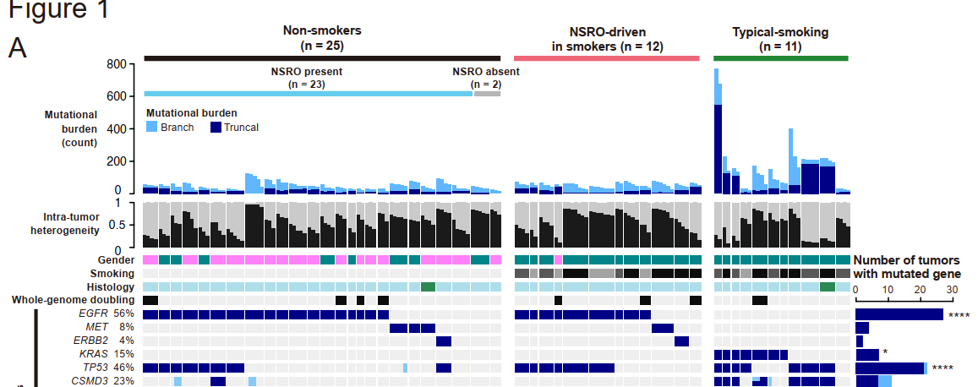
Some genomic characteristics of the 3 groups of tumors
NSRO-driven
in smokers
Typical smoking
NSRO-driven in non-smokers
Number of mutations
Huang, 2023, 10.1101/2023.07.04.547310

Slide 37
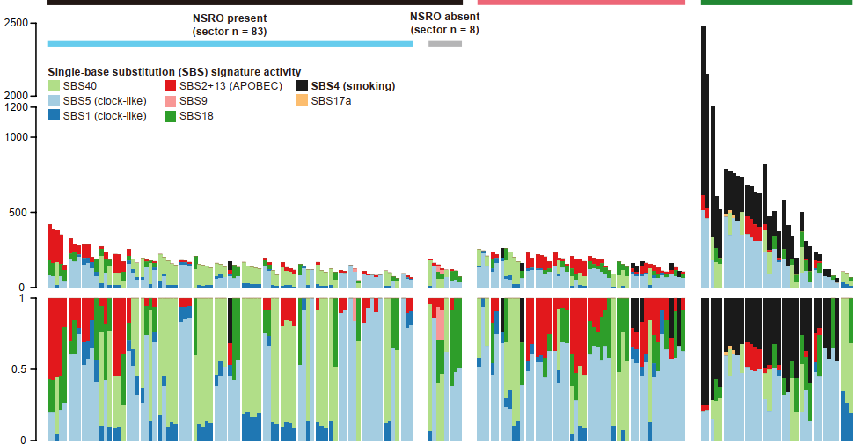
Mutational signature of smoking is absent from NSRO-driven tumors in smokers
NSRO-driven
in smokers
Typical smoking
NSRO-driven in non-smokers
Number of mutations
Proportion of mutations
Huang, 2023, 10.1101/2023.07.04.547310

Slide 38
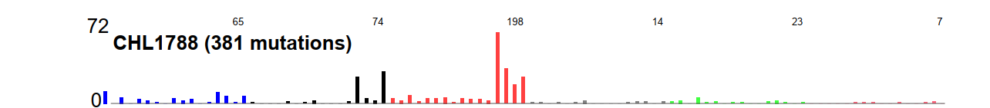
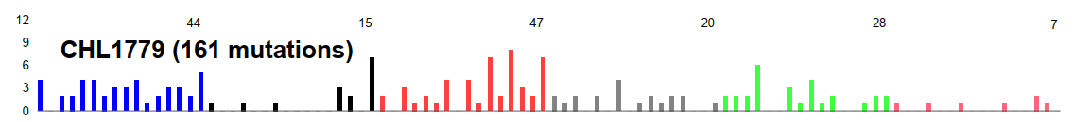
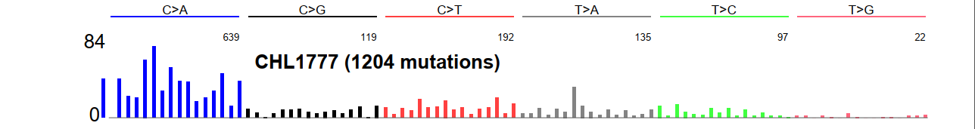
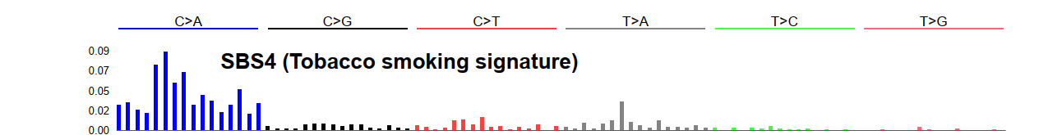
Example spectra
NSRO-driven
in non-smoker
Number of
mutations
Number of
mutations
12
NSRO-driven
in smoker
0
Typical
smoker
Number of
mutations
Pro- portion
of mutations
0.9
Smoking
signature
0
Huang, 2023, 10.1101/2023.07.04.547310
Notes:
Note ABOBEC, slow counts of blue C -> A; blue in CHL1779 is probably from SBS18, maybe ROS related

Slide 39
Questions about NSRO-driven lung cancer in smokers
Different cell of origin than “typical smoking” tumors?
Selection against tobacco-mutated cells?
Does tobacco contribute to oncogenesis in NSRO-driven tumors in smokers through non-mutagenic mechanisms?

Slide 40
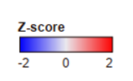
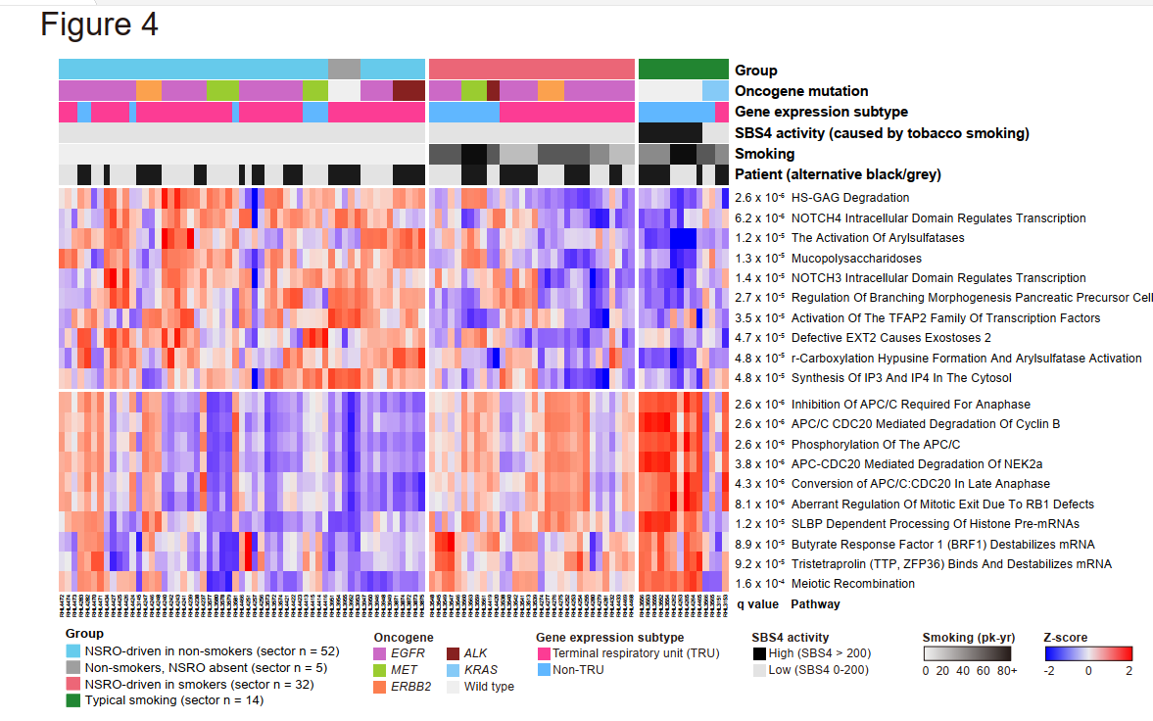
Suggestive evidence that smoking still plays a role in NSRO-driven cancers in smokers
Non-Smokers
NSRO-driven
Smokers
NSRO-driven Typical
Transcriptome differences between smokers and non-smokers regardless of NSRO status
Huang, 2023, 10.1101/2023.07.04.547310

Slide 41
Outline
Background on mutational signatures
Many East Asian lung cancers in smokers do not have mutations due to smoking
AA (aristolochic acid, 馬兜鈴酸) and liver cancer

Slide 42
Why is AA important?

Slide 43
1990s: AA emerged as a human health problem
~100 young women developed end stage kidney disease
Single weight-loss clinic in Europe
漢防己, hàn fáng jǐ replaced by 廣防己, guǎng fáng jǐ
Notes:
Dose: (Cosyns 2003; Nortier et al. 2000)
Adducts: Nortier et al., 2000

Slide 44
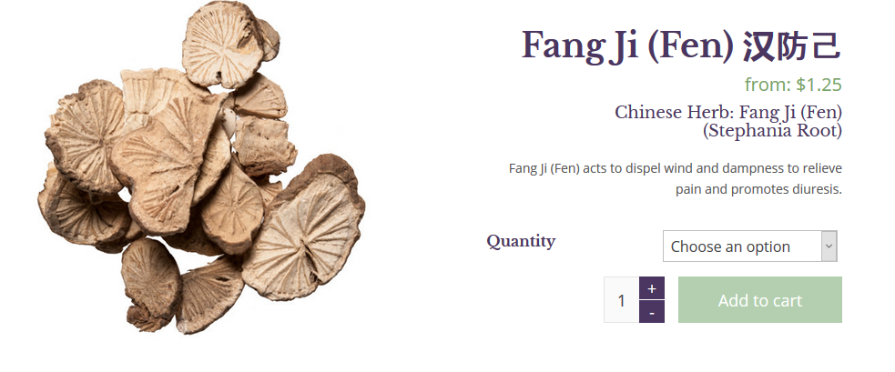
漢防己, hàn fáng jǐ (genus Stephania – no AA)

Slide 45
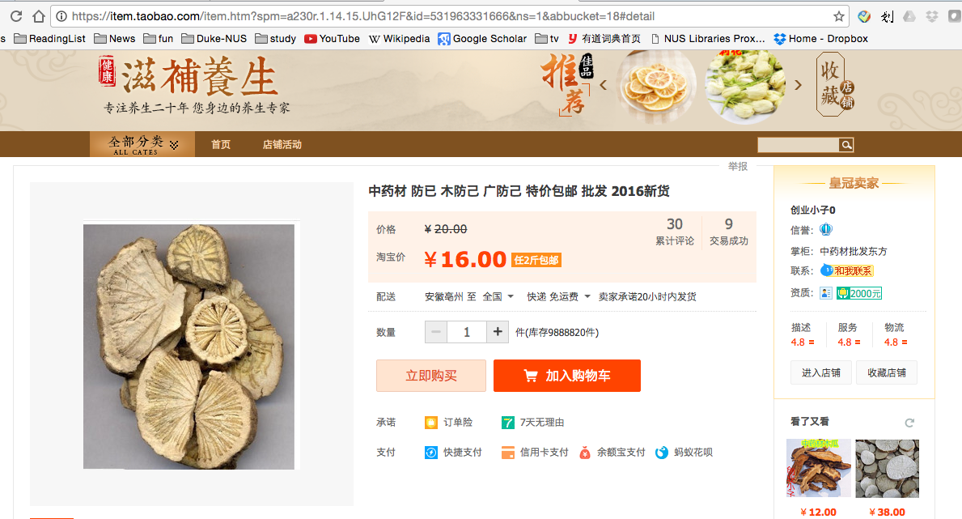
廣防己, guǎng fáng jǐ (genus Aristolochia – has AA)
Notes:
Total of 0.5 g over average of 13 months
AA adducts

Slide 46
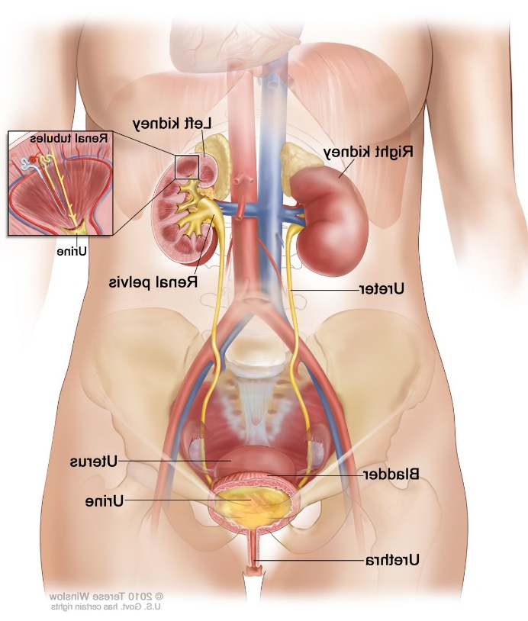
AA identified as a carcinogen:
Many of the AA-kidney-failure victims developed upper tract urothelial cancer
(Nortier et al., 2000, NEJM)

Slide 47
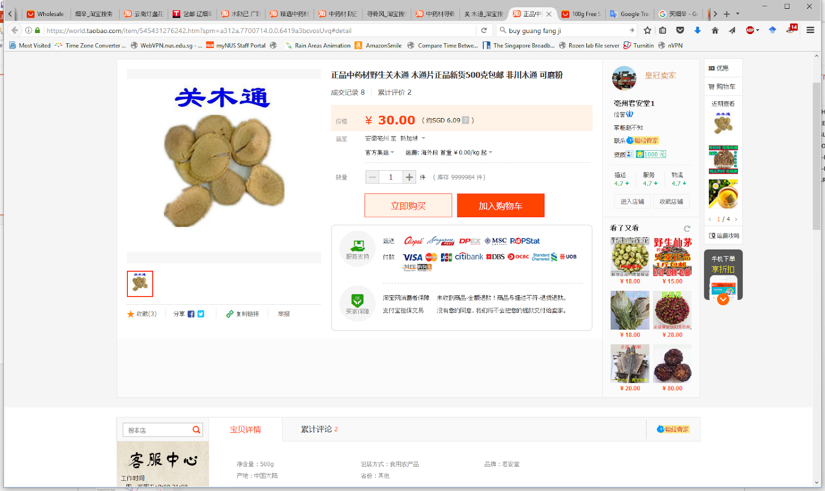
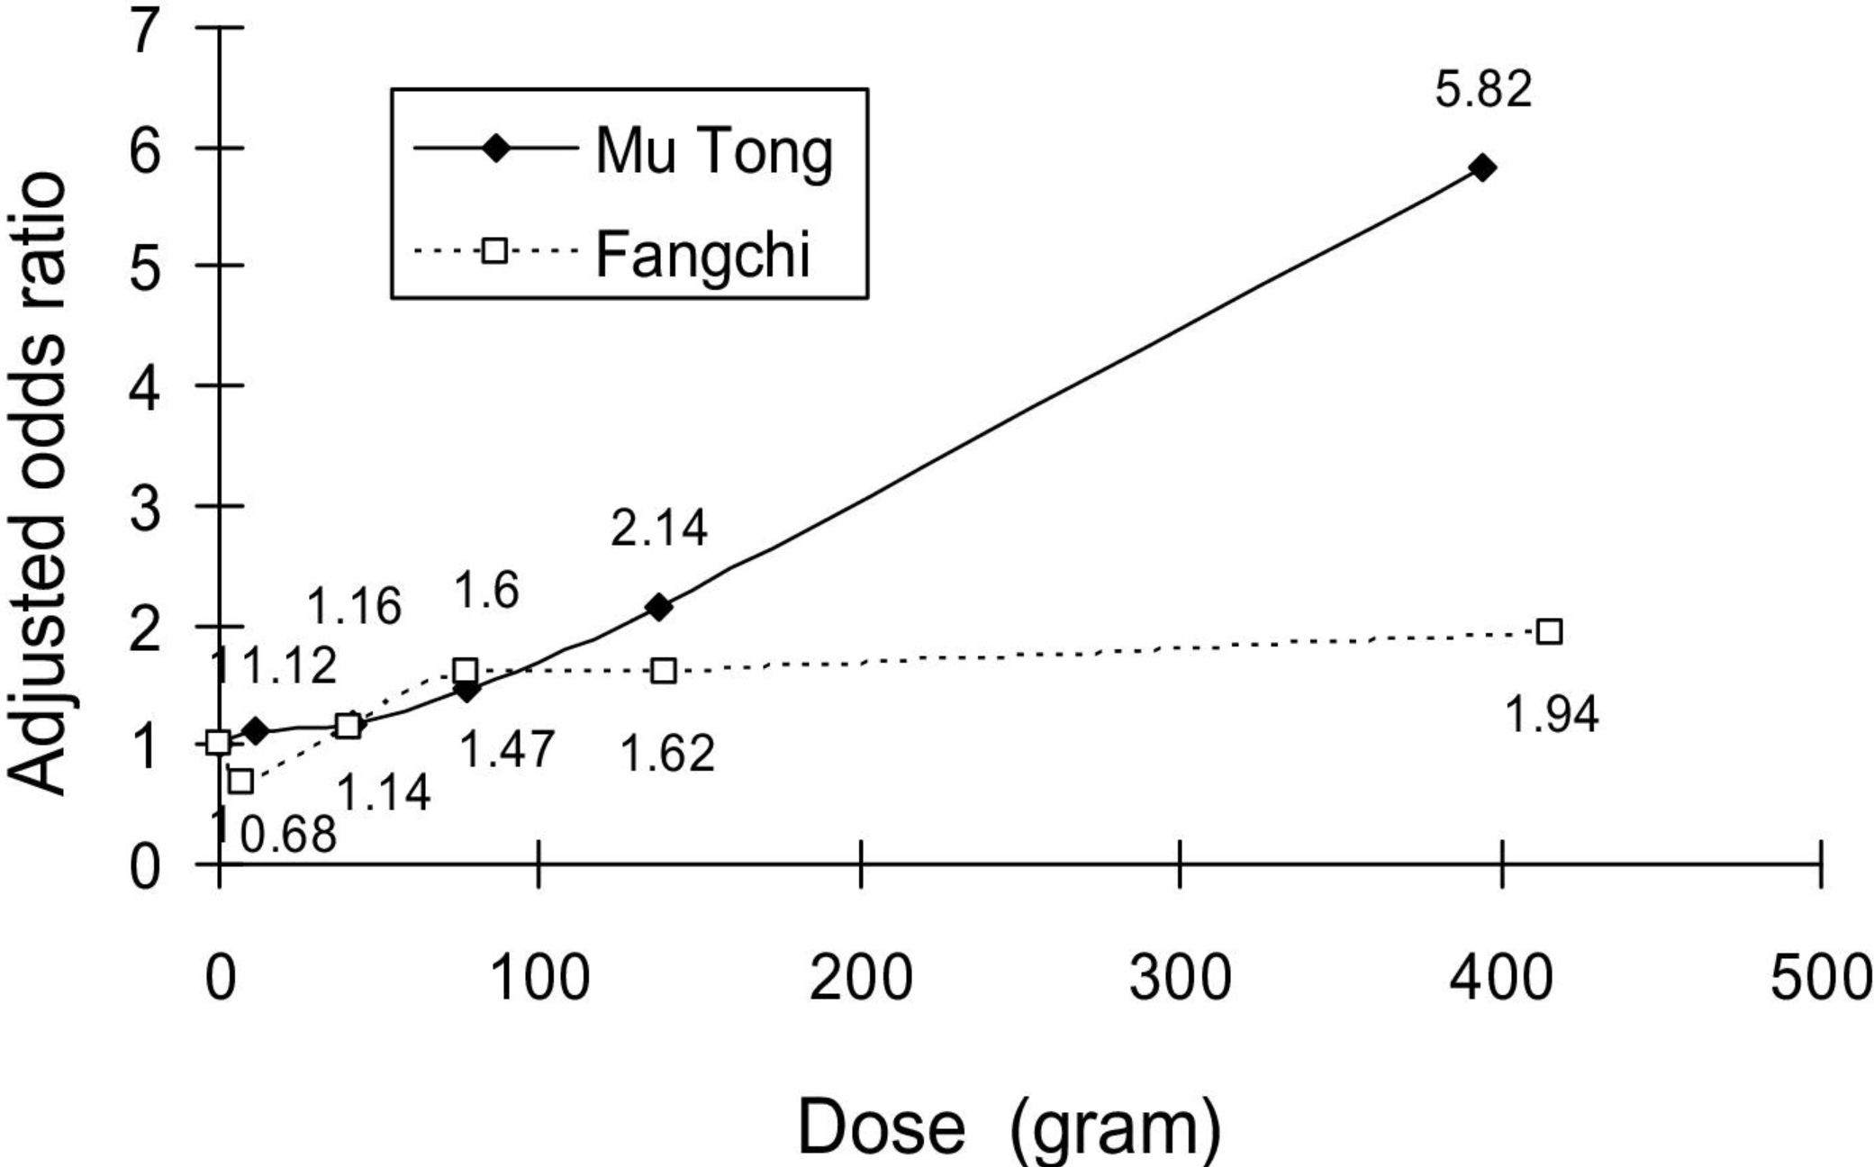
2010: AA-containing herbs cause kidney disease in Taiwan
End-stage renal disease caused by 2 herbs
Adjusted odds ratio for end-stage renal disease
防己
Lai et al, 2010 10.1053/j.ajkd.2009.10.055

Slide 48
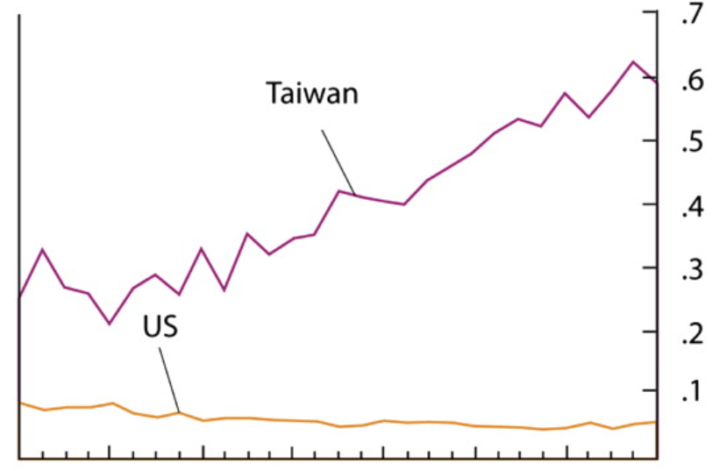
2013 Excess upper tract urothelial cancer versus bladder cancer in Taiwan presumably caused by AA
Incidence ratio of
upper-tract
urothelial cancer
to
bladder cancer
1979
2007
Chen et al, 2012 10.1073/pnas.1119920109

Slide 49
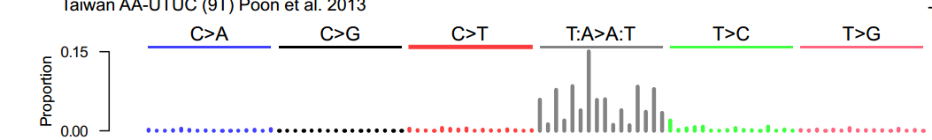


Mutational signature in an AA-exposed upper tract urothelial carcinoma from Taiwan
More
mutations
Each bar represents the total number of single nucleotide mutations in a particular context
Highest bar represents the number of CAG to CTG mutations across the entire genome
The higher the bar, the more CAG to CTG mutations
Poon et al. and Hoang et al. , Science Translational Medicine, 2013
Songling Poon
Jacob Pang

Slide 50
Mutational signature in an AA-exposed upper tract urothelial carcinoma
More
mutations
AAG > ATG mutations
Not as many
Highest bar represents the number of CAG to CTG mutations across the entire genome
The higher the bar, the more CAG to CTG mutations
Mutations from C to A, C to G, C to T
Almost none
Poon et al. and Hoang et al. , Science Translational Medicine, 2013

Slide 51
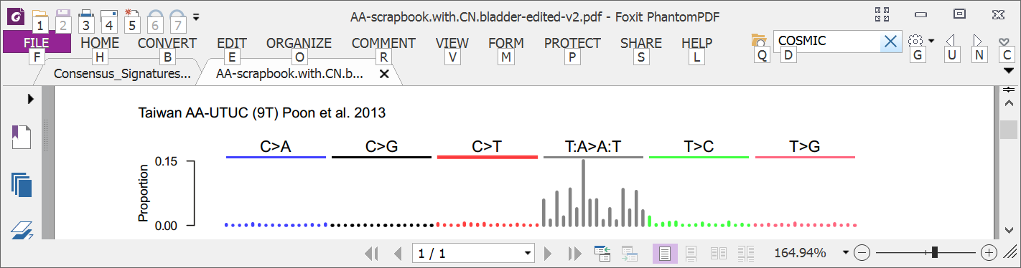
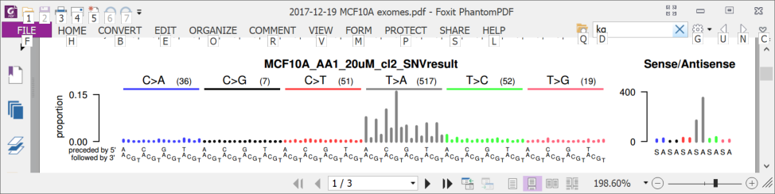
2013: AA mutational signature in upper tract urothelial cancer and cell lines
Upper tract urothelial
AA exposed cell line
Poon et al. and Hoang et al. , Science Translational Medicine, 2013

Slide 52
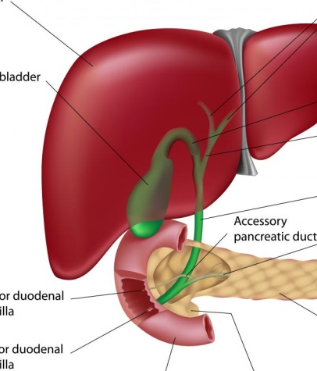
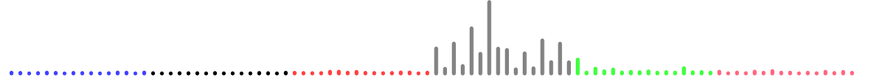
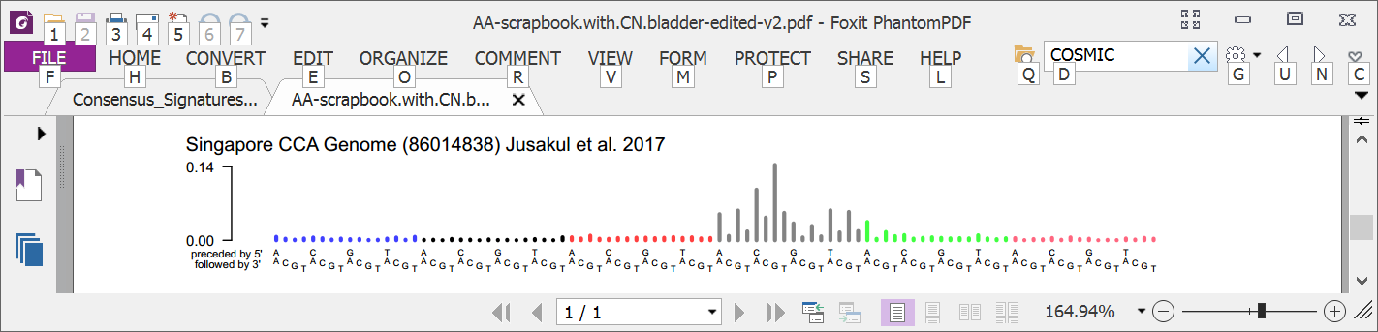
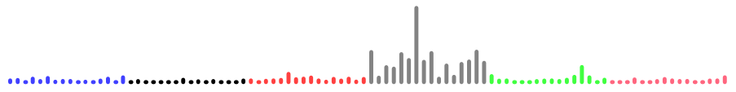
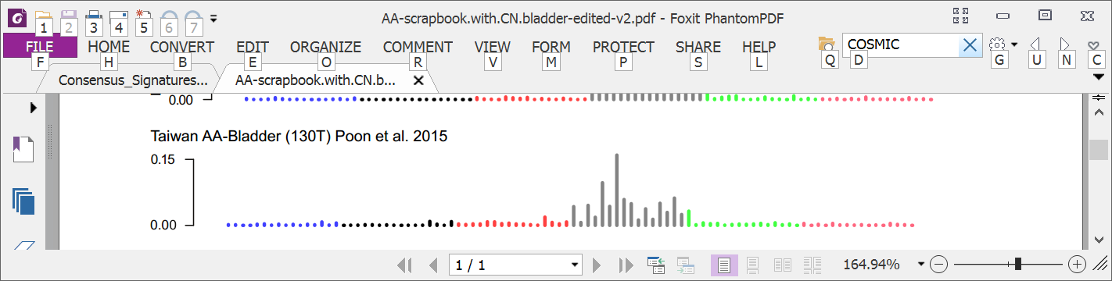
2016: AA mutational signature in multiple tumor types
Liver
Bile duct
Kidney
Upper tract urothelial
Bladder
Poon et al., 2013 and subsequent data (liver - hepatocellular carcinoma [HCC])
Zou et al., 2015, Jusakul et al., 2017 (bile duct carcinoma)
Scelo et al., 2014, Jelakovic et al., 2014 (kidney/renal cell carcinoma)
Poon et al., 2013, Hoang et al., 2013, many others (upper tract urothelial carcinoma)
Poon et al., 2015, others (bladder urothelial carcinoma)

Slide 53

2016: Taiwan a known hotspot for AA kidney failure and AA upper-tract urothelial cancer A good place to investigate AA in liver cancer
Chen, …., Grollman, PNAS, 2012
Map created by Freepik

Slide 54
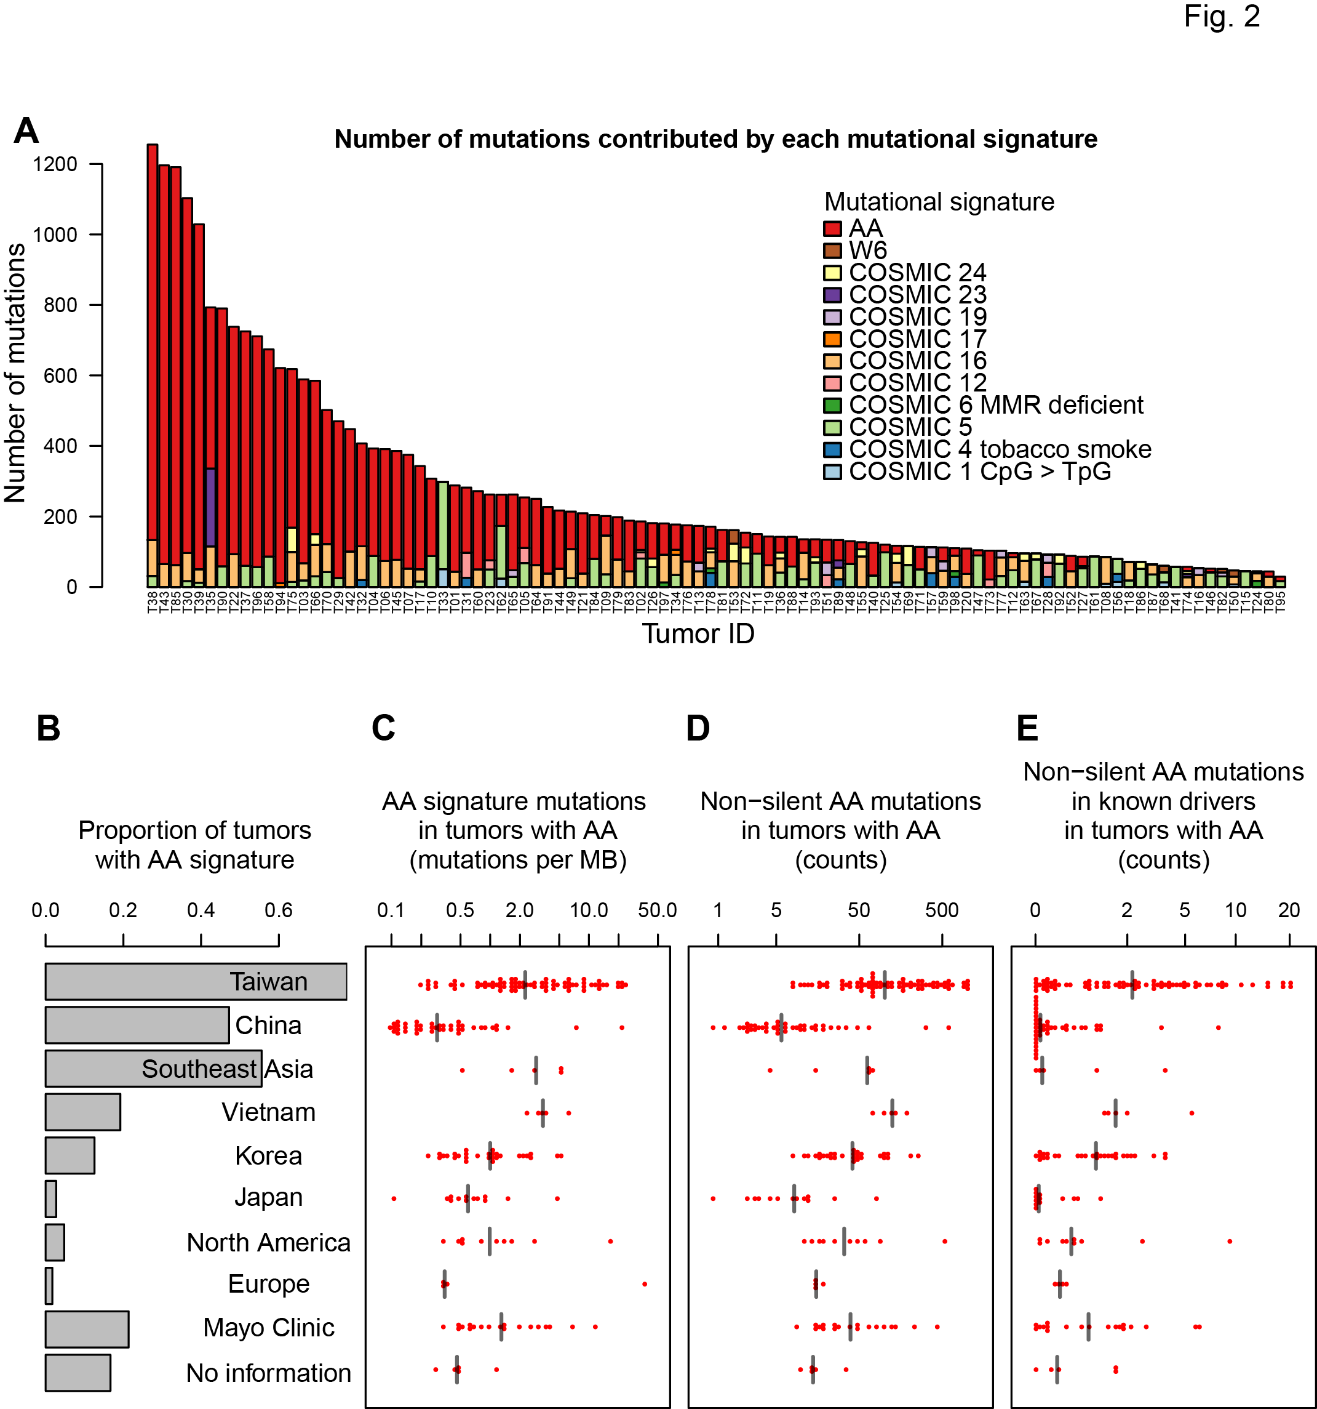
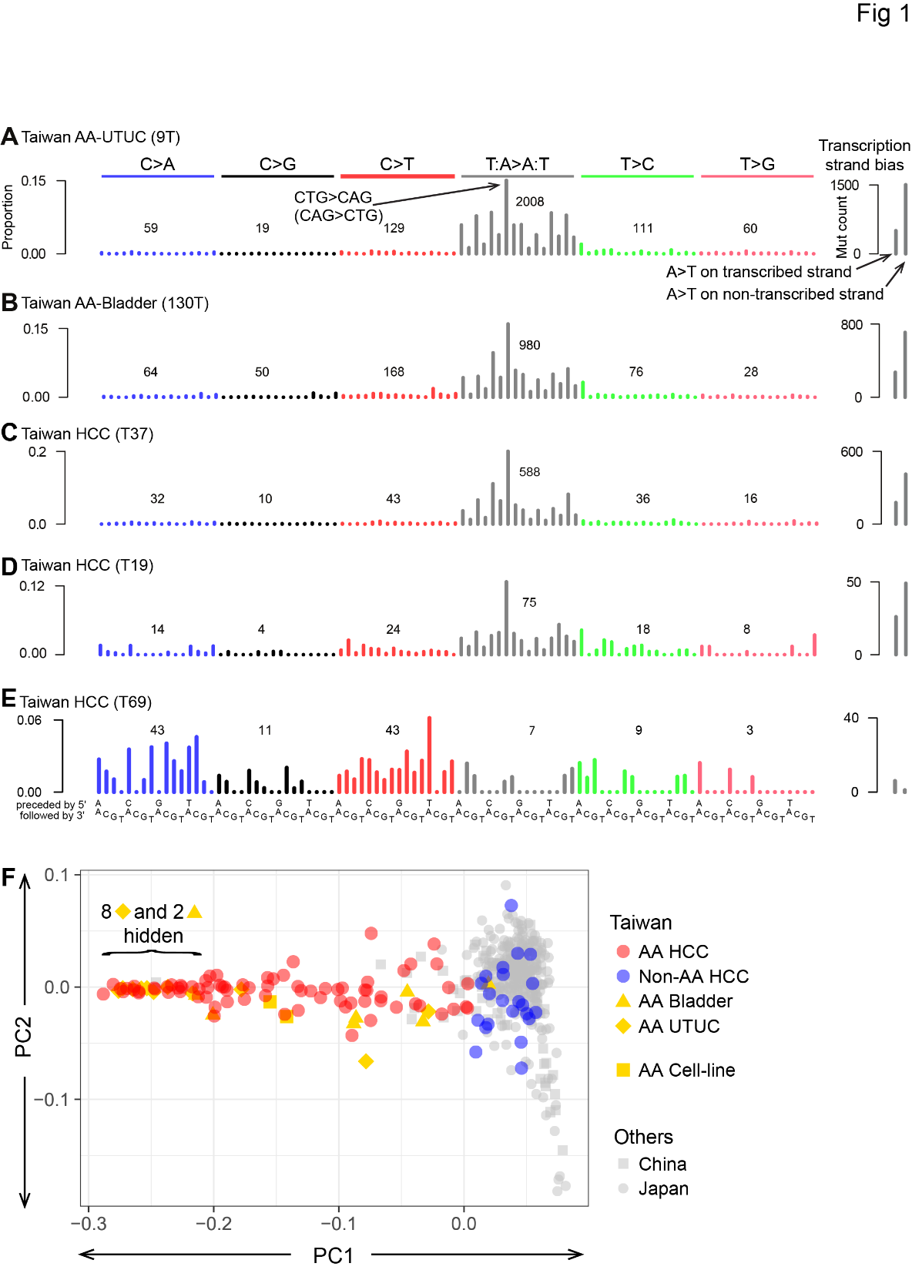
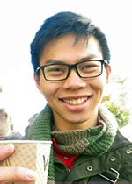
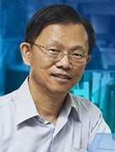
2017: 78% of Taiwan liver cancers (HCCs) had the AA signature (paper from my lab)
Alvin Ng Sen-Yung Hsieh
Red bars show
numbers of
mutations
caused by AA
黄伟添 谢森永
Ng, Poon, et al., Oct 2017 DOI: 10.1126/scitranslmed.aan6446

Slide 55
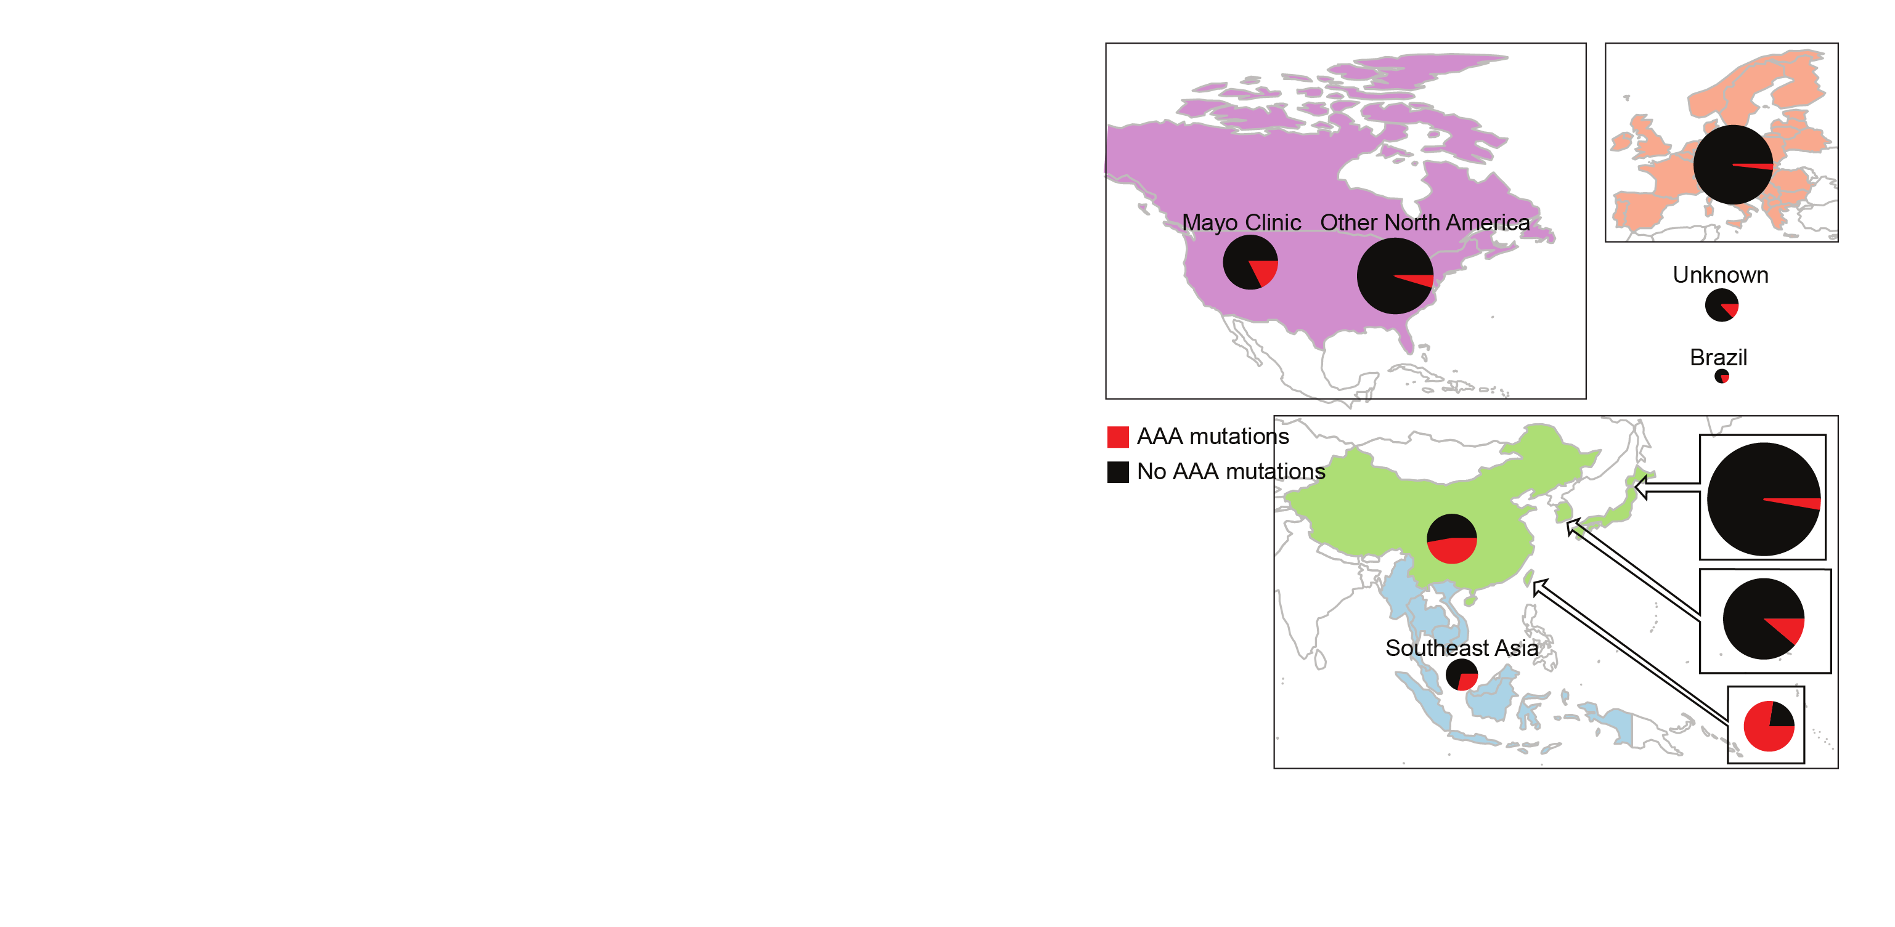
Today: 2,000 liver cancers – AA exposure is prevalent
AA mutations
No AA mutations
“Asian” patients with no “country” – Overseas patients?
Ng, Poon, et al., Oct 2017 DOI: 10.1126/stranslmed.aan6446 and subsequent publications; Zhang et al., 2017, Gastroenterology, 10.1053/j.gastro.2017.03.024; Xue et al., 2019, Cancer Cell,10.1016/j.ccell.2019.04.007, 2021 Unpublished data, 2021

Slide 56
Many AA-exposed liver cancers have multiple known cancer driver genes with AA mutations (as of 2017)
Number of AA mutations
in known driver genes,
per tumor
Taiwan
Mainland China
Other SE Asia
Vietnam
Korea
Japan
North America
Europe
Mayo Clinic
Unknown
Geographical region
Ng, Poon, et al., Oct 2017 DOI: 10.1126/scitranslmed.aan6446

Slide 57
AA can cause liver cancer
AA mutations
No AA mutations
Known mutagen and urinary tract carcinogen
Multiple known cancer driver genes with AA mutations
Linear relationship between AA dose and risk of liver cancer in hepatitis-B-infected and hepatitis-C-infected patients
AA causes liver cancer in mice
“Asian” patients with no “country” – Overseas patients?
Ng, Poon, et al., Oct 2017 DOI: 10.1126/stranslmed.aan6446 and subsequent publications; Zhang et al., 2017, Gastroenterology, 10.1053/j.gastro.2017.03.024; Xue et al., 2019, Cancer Cell,10.1016/j.ccell.2019.04.007; Hsieh et al., 2008, 10.1186/1749-8546-3-13; Chen et al., 2018, International Journal of Cancer, 10.1002/ijc.31544; Chen et al., 2019,Cancer Epidemiology, Biomarkers & Prevention, 10.1158/1055-9965.EPI-19-0023; Lu et al. 2019 Hepatology, 2019, 10.1002/hep.30863

Slide 58
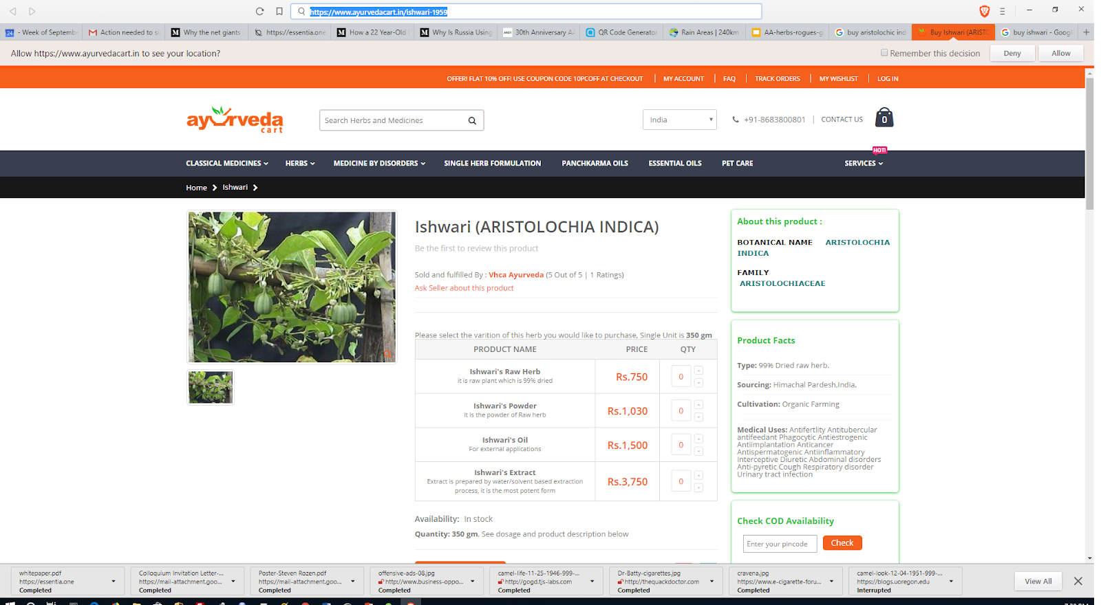
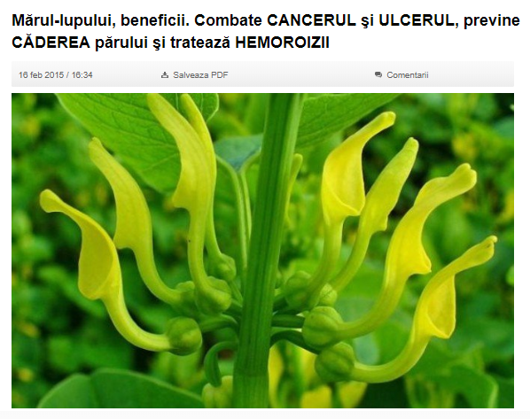
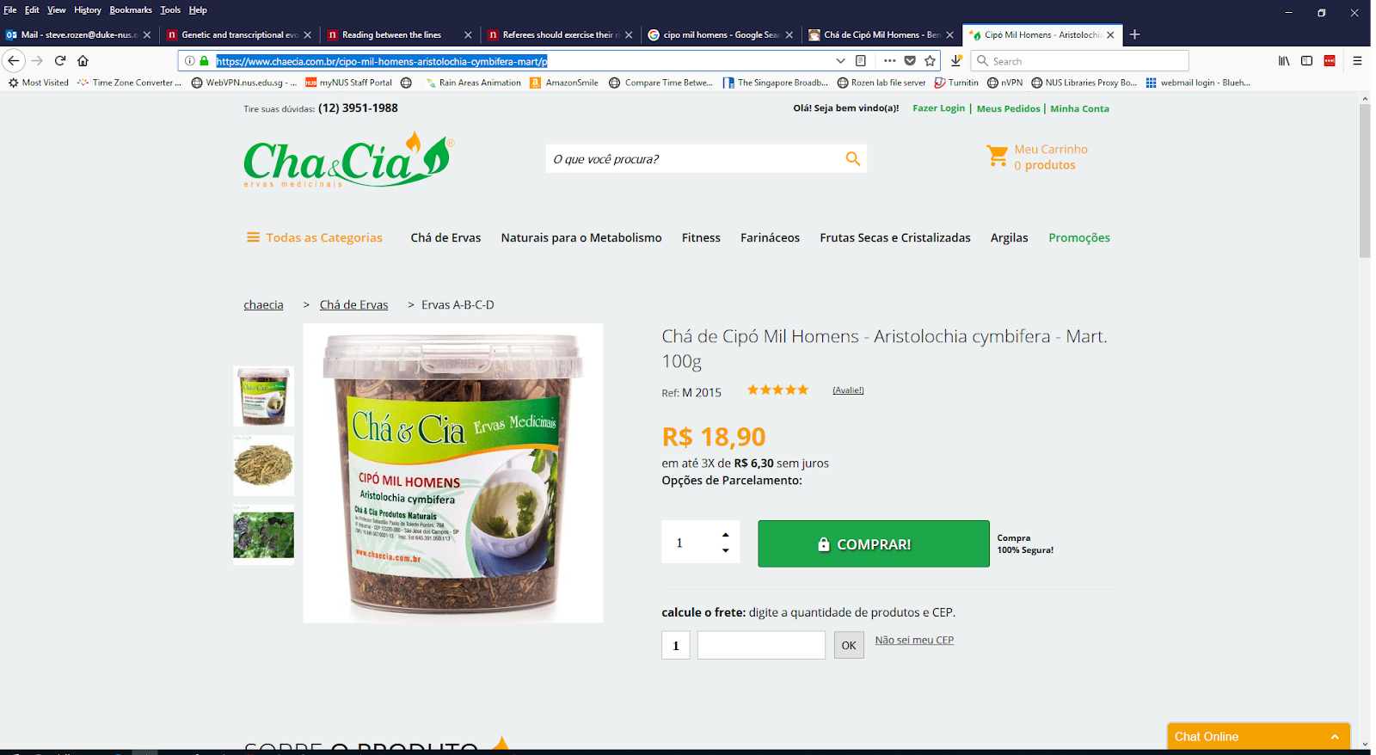
AA is not only an East Asian problem
Romania
India
Aristolochia indica
Brazil
Aristolochia clematitis
Combats cancer, ulcers, prevents hair loss and hemorrhoids
Aristolochia cymbifera

Slide 59
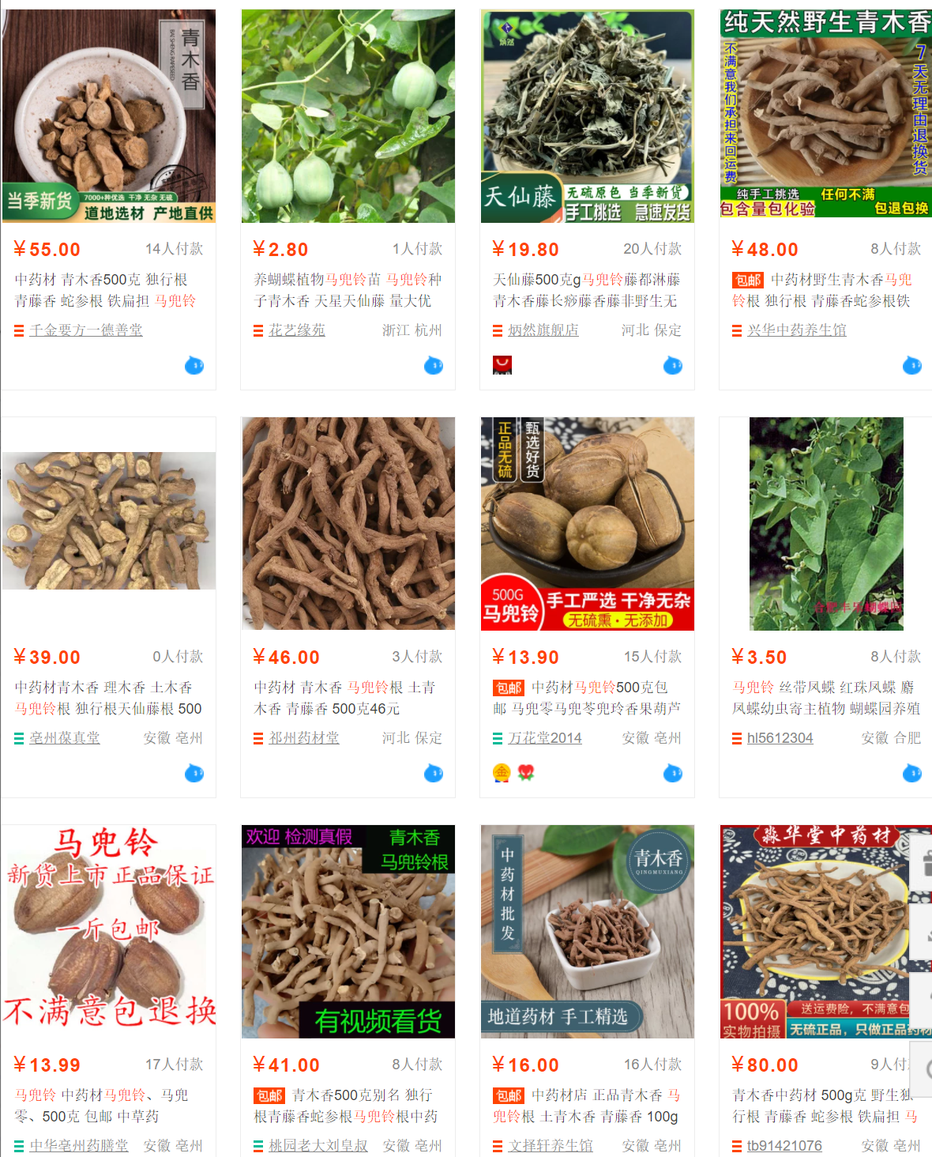
“Banned”?
Top results of a search for ma dou ling (马兜铃, Aristolochia contorta or A. debilis) on a popular Mainland shopping web site on 9 July 2021
马兜铃, lower left), roots of the same species (known as 青木香), and above-ground parts (天仙藤，top row, third from left), and seedlings (top row, second from left)

Slide 60
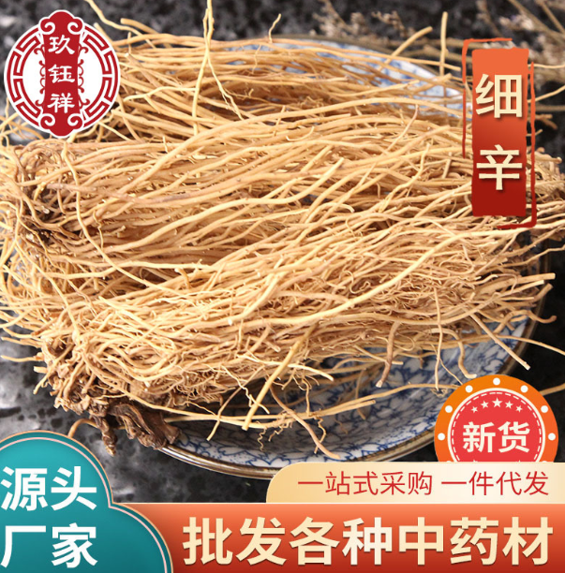
“Banned”?
Highly variable AA content
Usually low or none
Sometimes high AA content

Slide 61
AA conclusions
AA appears to be a widespread problem that for unknown reasons especially affects Taiwan
I propose this needs much more research
Most important question:
How are people being exposed? Is it always herbal medicine? Which herbs? How prepared?

Slide 62
AA more questions
What is the dose-risk relationship between AA exposure and liver cancer? Is there interaction with hepatitis?
What is the extent of exposure in India, Africa and Latin America?
What are effective approaches to education and regulation?
Can non-invasive tests (e.g. blood tests) for AA exposure be developed for clinical or research use?
A non-invasive test would enable secondary prevention: exposed individuals might benefit from screening
How to convince funders that prevention is worthy of funding even it will not help anyone who already has cancer?

Slide 63
Overall conclusions – main points
We can use mutational signatures to understand the causes of somatic mutations
When somatic mutation contribute to cancer development, mutational signatures provide insight into the causes of cancer
We talked about 2 examples:
Lack of smoking mutations in NSRO-driven lung cancer even in smokers; why?
Widespread mutagenesis by AA in multiple cancer types (we focused on liver cancer)

Slide 64
Acknowledgements - Funding
Singapore National Medical Research Council
Singapore Ministry of Health via the Duke-NUS Signature Research Programmes
Chang Gung Memorial Hospital (CGMH) Foundation
Chang Gung Medical Foundation
Duke-NUS Khoo Postdoctoral Fellowship Award
United States National Institutes of Health

Slide 65

Acknowledgements
Singapore (Duke NUS, National Cancer Centre Singapore, Genome Institute Singapore, Johns Hopkins Singapore)
Huang Chen-Yang (黃振洋)
Arnoud Boot
Mo LIU (刘陌)
Alvin NG Wei Tian (黄伟添)
Nanhai JIANG (蒋南海)
Shenli Zhang
Szu-Chi Ho
Willie Yu
Cedric C. Y. Ng
Patrick Tan
Bin Tean TEH
Songling Poon
Alex Chang
Daniel Tan
Anders Skanderup
Sen-Yung Hsieh (谢森永)
Jacob See-Tong PANG
Hao-Yi Huang
Ming-Chin Yu
Po-Hung Lin (林柏宏)
Wen-Hui Weng
Ying-Hsu Chang
Kai-Jie Yu,
Kwai-Fong Ng
Ching-Fang Wu
Cheng-Lung Hsu
Cheng-Keng Chuang
Pan Cancer Analysis of Whole Genomes (PCAWG)
Many, including
Ludmil Alexandrov
Mike Stratton
Mi Ni Huang
Jaegil Kim
Gaddy Getz

Slide 66
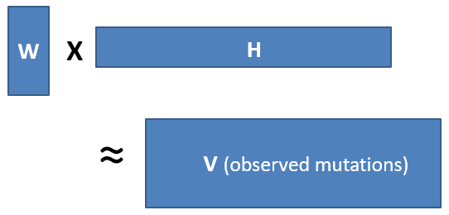
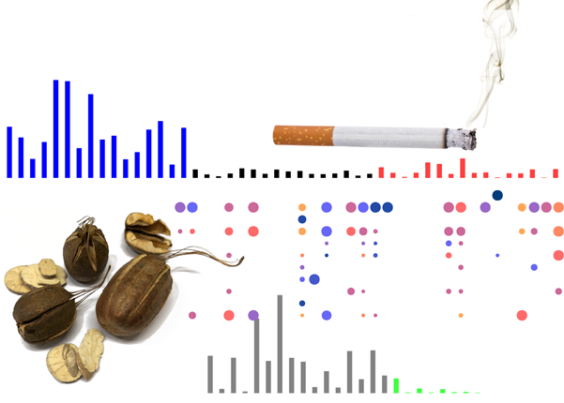
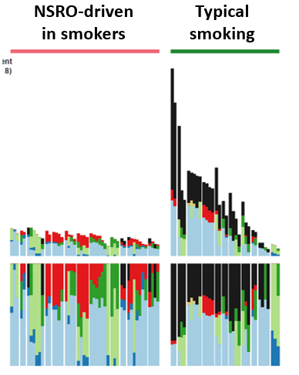
Questions?
Slides at
https://github.com/Rozen-Lab/msigs

Slide 67
Backup slides

Slide 68
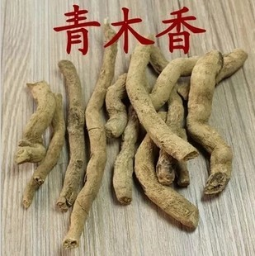
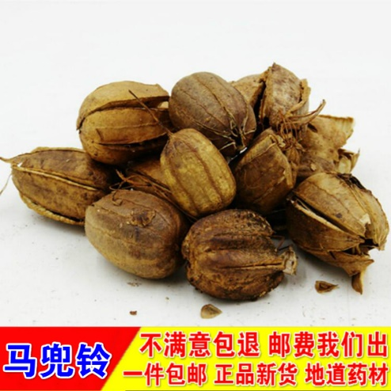
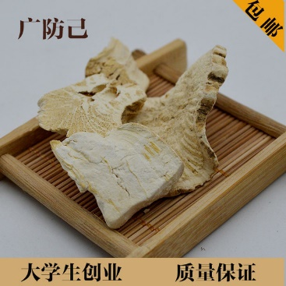
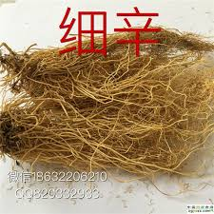
Aristolochic acid (AA) occurs naturally in plants widely used as herbal medicine

Slide 69
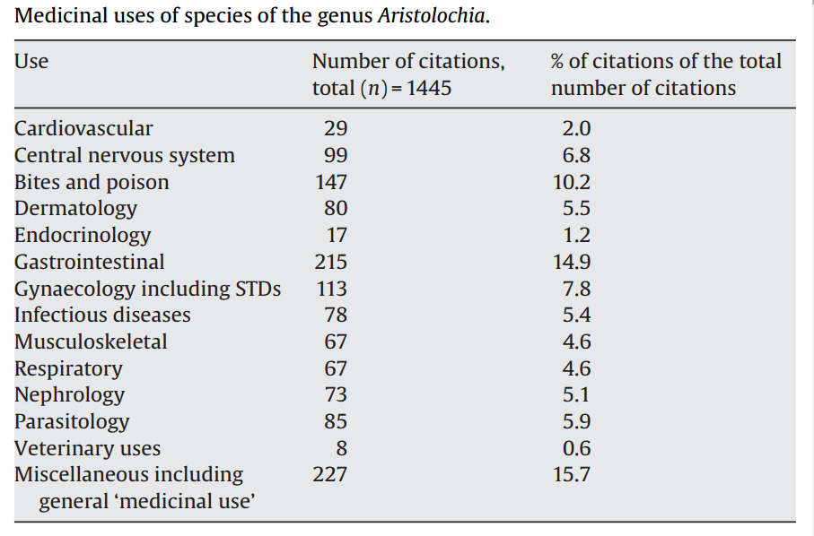
M. Heinrich et al 2009
doi:10.1016/j.jep.2009.05.028

Slide 70
Table S6. Drivers identified by MutSigCV or 20/20+ in 98 Taiwan HCCs.
Gene | Proportion of Taiwan HCCs with mutation | Classification in Cancer Gene Census | Notes | Proportion with mutations in TCGA 2017
TP53 | 0.54 | TSG | Commonly mutated in HCC | 0.31
CTNNB1 | 0.24 | oncogene | Commonly mutated in HCC | 0.27
ALB | 0.21 |  | Commonly mutated in HCC, status as driver controversial | 0.13
AXIN1 | 0.17 | TSG | Commonly mutated in HCC | 0.08
DOCK8 | 0.11 |  | Not expressed in liver or liver cancer (http://www.proteinatlas.org/ENSG00000107099-DOCK8/cancer); not observed in any other HCC genomic study | NR
BRD7 | 0.09 |  | Observed in Totoki et al., 2014 , Fujimoto et al., 2016 | NR
ARID2 | 0.09 | TSG | Observed in multiple other HCC genomic studies | 0.05
RPS6KA3 | 0.08 |  | Observed in multiple other HCC genomic studies | 0.04
IRF2 | 0.06 |  | Reported as an HCC TSG in Guichard et al., 2012 | NR
RAG1 | 0.06 |  | Activation of immunoglobulin V-D-J recombination.; not likely to have a role in hepatocytes or liver cancer | NR
RB1 | 0.06 | TSG | Observed in multiple other HCC genomic studies | 0.04
PBRM1 | 0.05 | TSG | Observed in multiple other HCC genomic studies | NR

Slide 71
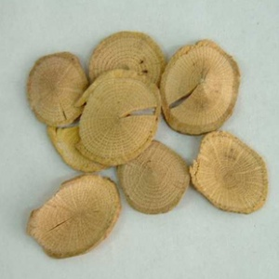

Variable and diverse AA content
Each column is a sample
关木通 guān mù tōng (stem of
Aristolochia manshuriensis)
High concentration
Each row is a different AA analog
Low concentration
Michl et al., 2015, J. Natural Products doi:10.1021/acs.jnatprod.5b00556
Notes:
https://www.e138.net/zhongyao/cai-141.html

Slide 72

Variable and diverse AA content
Each column is a sample
天仙藤 tiān xiān téng (thin stems and leaves of Aristolochia debilis)
High concentration
Each row is a different AA analog
Low concentration
Michl et al., 2015, J. Natural Products doi:10.1021/acs.jnatprod.5b00556

Slide 73
2021 AA adducts and mutations in normal and other non-cancer tissue
Liver - adducts and mutational signature (Brunner et al, 2019, doi: 10.1038/s41586-019-1670-9)
Bladder and upper tract urothelia - mutational signature (Du et al., 2016; Lu et al., 2020, 10.7150/thno.43251; Li et al., 2020, 10.1126/science.aba7300)
Kidney - adducts
White blood cells - mutational signature (our unpublished results here)
Notes:
Poon et al., 2013 and subsequent data (liver - hepatocellular carcinoma [HCC])
Zou et al., 2015, Jusakul et al., 2017 (bile duct carcinoma)
Scelo et al., 2014, Jelakovic et al., 2014 (kidney/renal cell carcinoma)
Poon et al., 2013, Hoang et al., 2013, many others (upper tract urothelial carcinoma)
Poon et al., 2015, others (bladder urothelial carcinoma)

